Slide 1
IOT Based pollution monitoring system

Slide 2
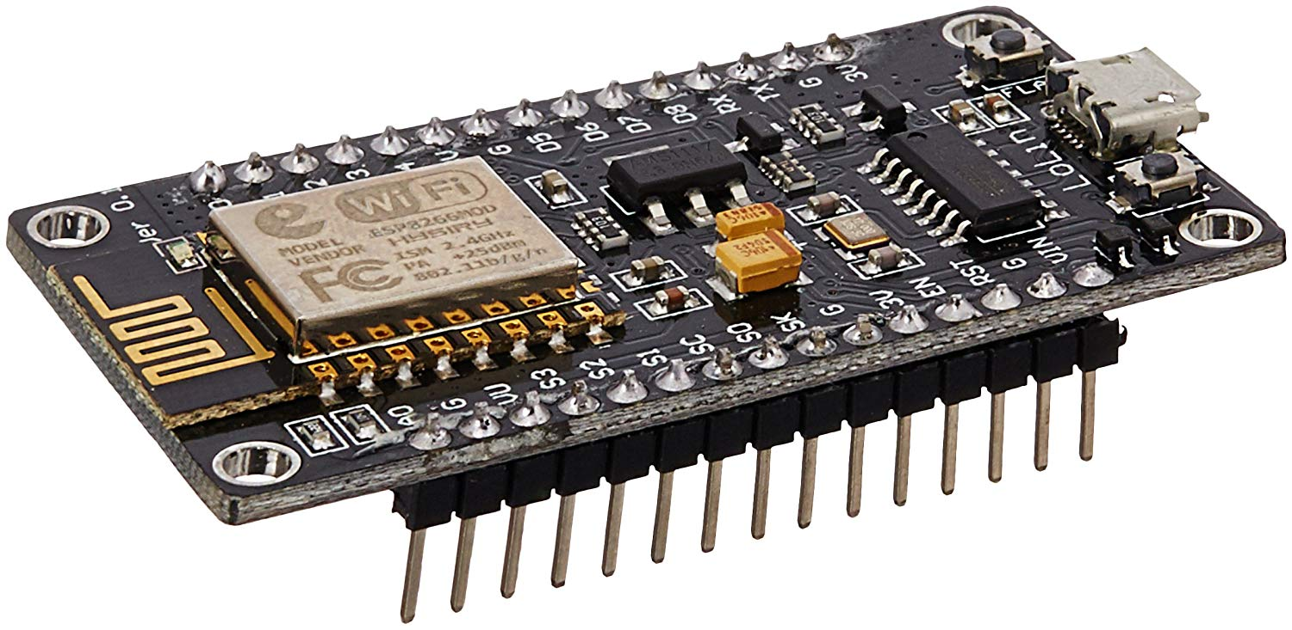
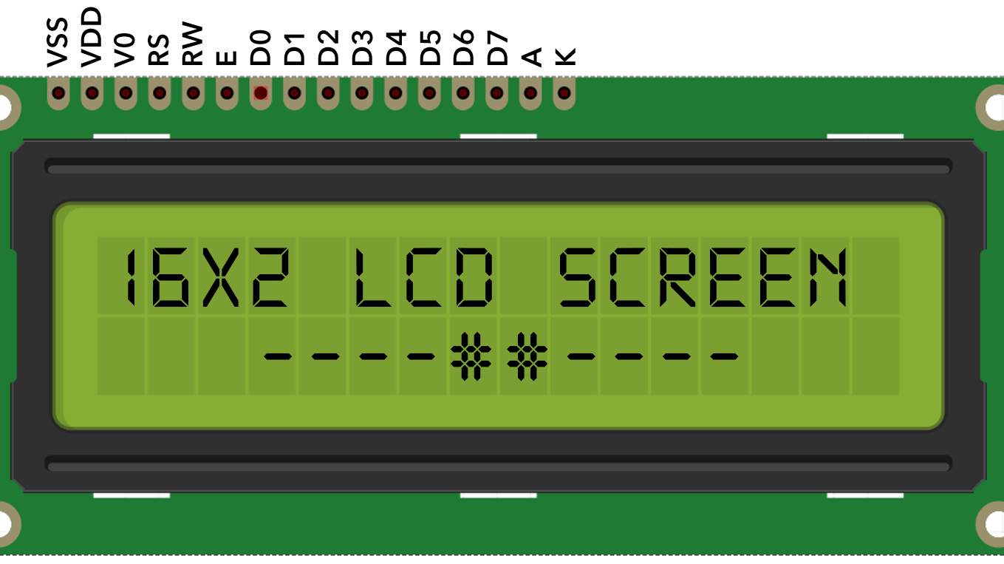
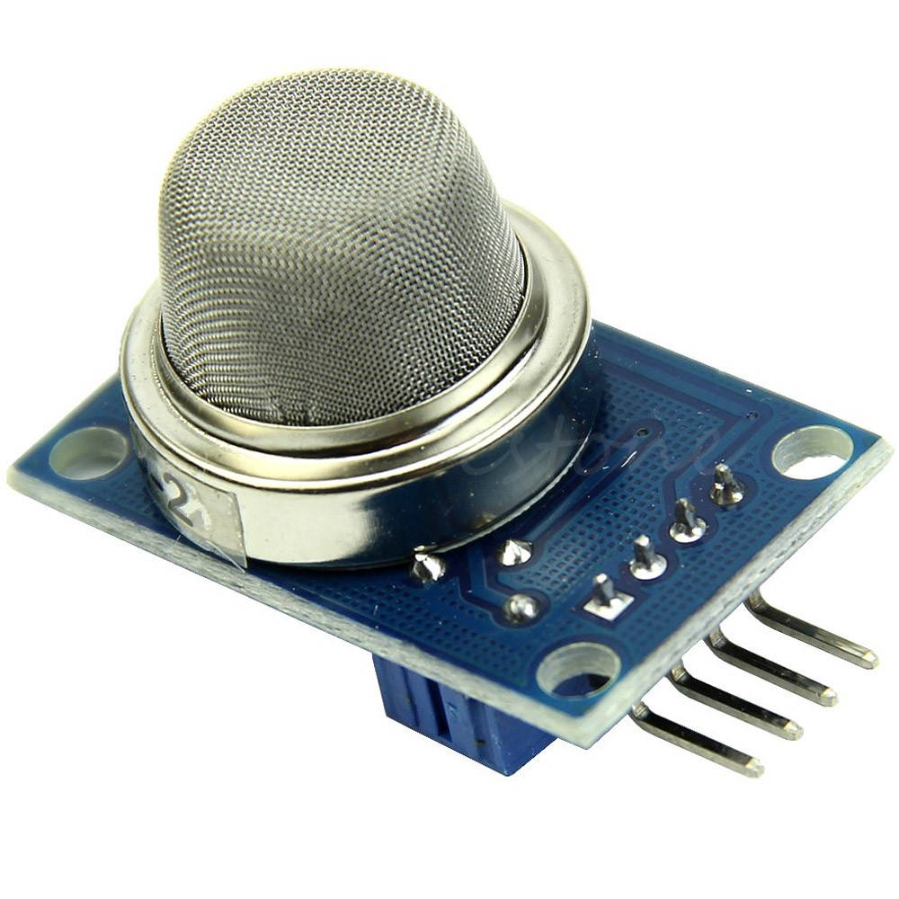
Components Used
Node MCU
16*2 LCD Display
MQ 2 Sensor

Slide 3
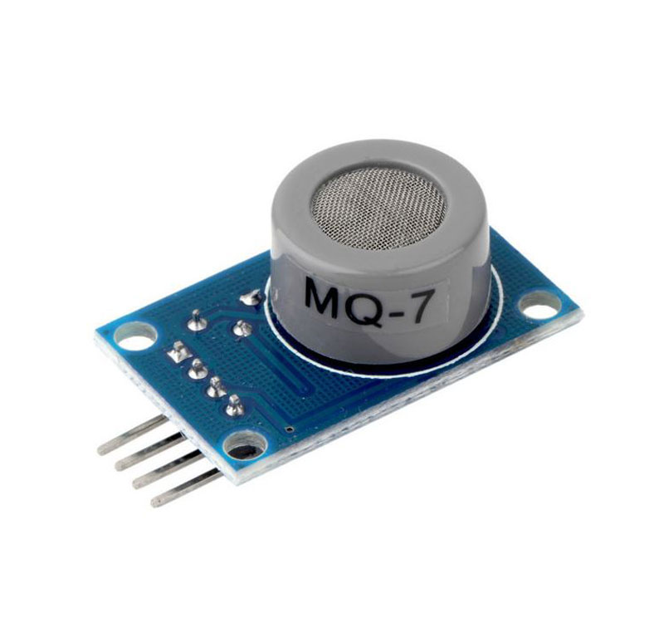
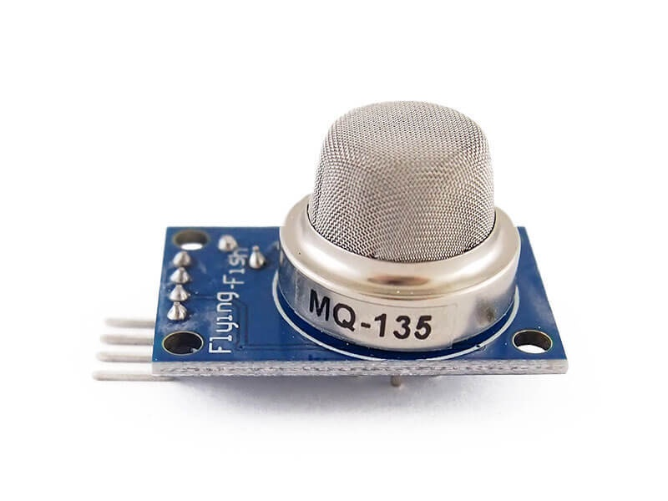
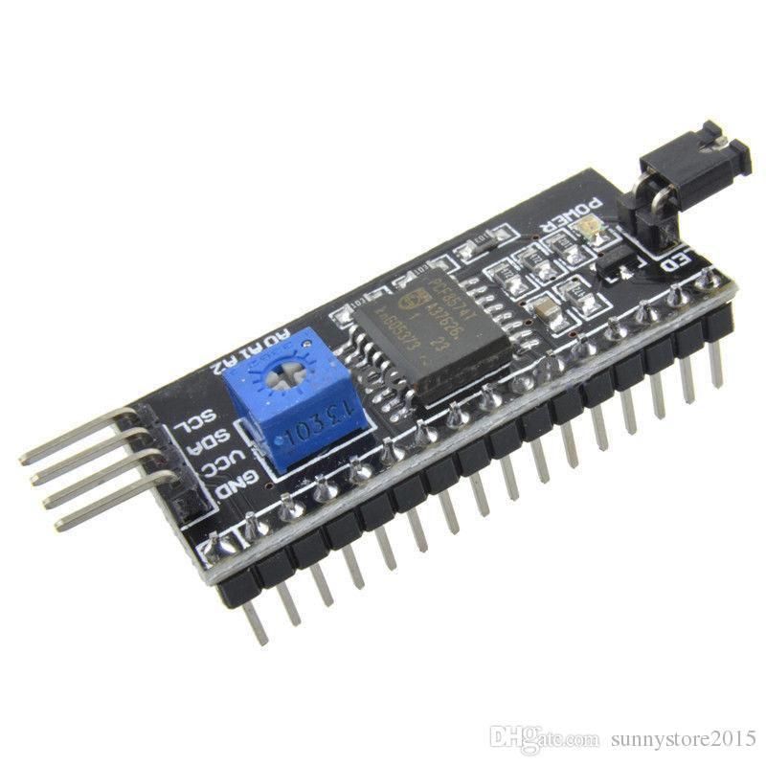
Components Used
Mq 7 Sensor
MQ 135 Sensor
I2C Module

Slide 4
Node MCU
NodeMCU is an open source LUA based firmware developed for ESP8266 wifi chip.
NodeMCU Dev Kit/board consist of ESP8266 wifi enabled chip. The ESP8266 is a low-cost Wi-Fi chip developed by Espressif Systems with TCP/IP protocol.
NodeMCU Dev Kit has Arduino like Analog (i.e. A0) and Digital (D0-D8) pins on its board.
It supports serial communication protocols i.e. UART, SPI, I2C etc.
RAM 128Kb
Flash Memory 4 Mb

Slide 5
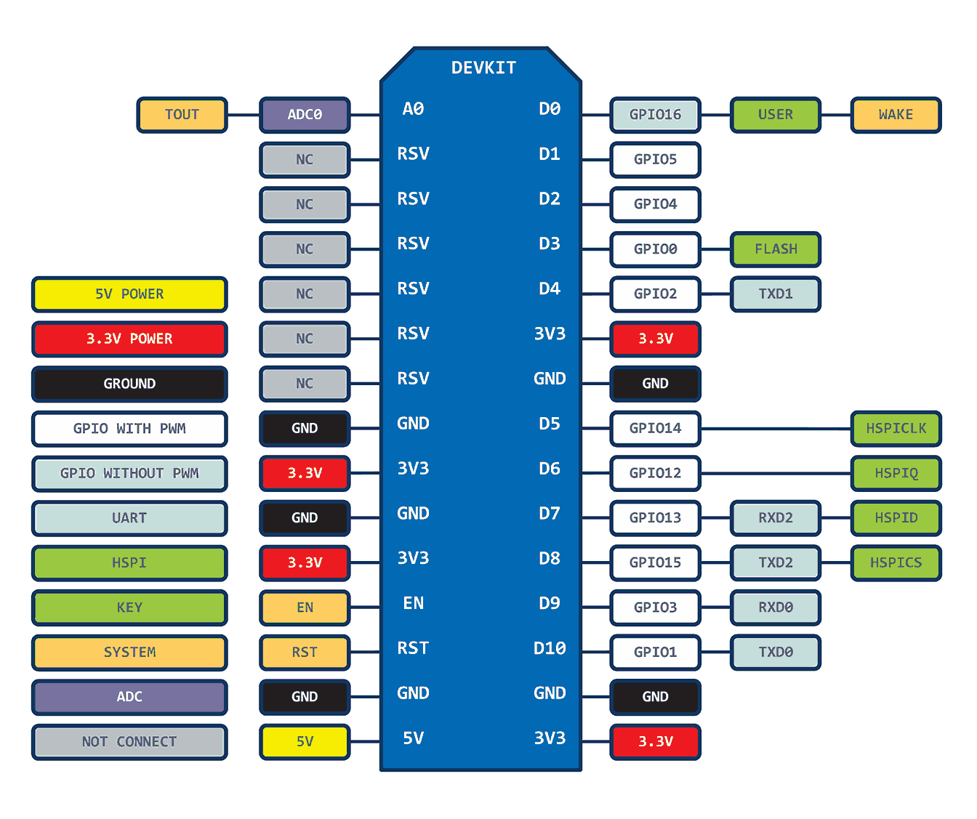
Pin configuration of node mcu

Slide 6
Lcd [16x2]
Operating Voltage 5V.
Backlight colour Green.
Horizontal Characters 16.
No. of Lines 2.
Supports MCU speeds up to 2Mhz.

Slide 7
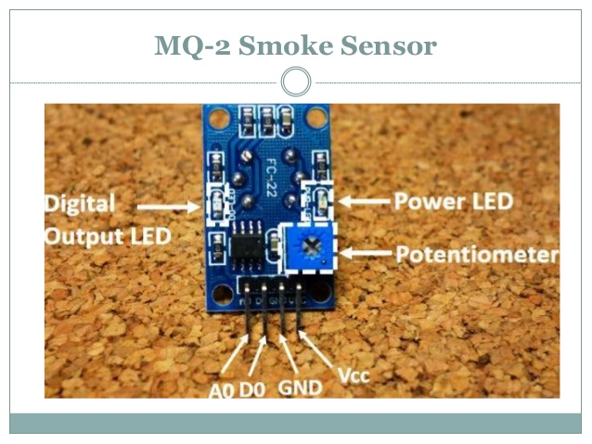
MQ 2
The MQ2 has an electrochemical sensor,which changes its resistance for different concentrations of varied Hydrocarbons (methane, propane, LPG etc).
The sensor is connected in series with a variable resistor to form a voltage divider circuit and the variable resistor is used to change sensitivity.
When one of the above gaseous elements comes in contact with the sensor after heating, the sensor’s resistance change.
The change in the resistance changes the voltage across the sensor by knowing the refrence voltage and the other resistor’s resistance.
The sensor outputs’s the voltage is directly proportional to concentration of smoke.

Slide 8
MQ 7
Sensitive for carbon monoxide.
Power: 2.5V ~ 5.0V.
The MQ-7 carbon monoxide sensor detects 20 to 2000 ppm of CO in air.

Slide 9
MQ 135
The MQ-135 Gas sensors are used in air quality control equipments and are suitable for detecting or measuring of NH3, NOx, Alcohol, Benzene, Smoke, CO2.
MQ-135 gas sensor applies SnO2 which has a higher resistance in the clear air as a gas-sensing material. When there is an increase in polluting gases, the resistance of the gas sensor decreases along with that.

Slide 10
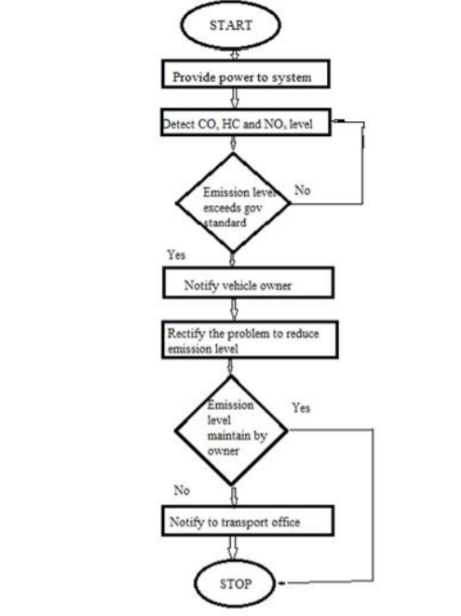
Flowchart of proposed mechanism:

Slide 11
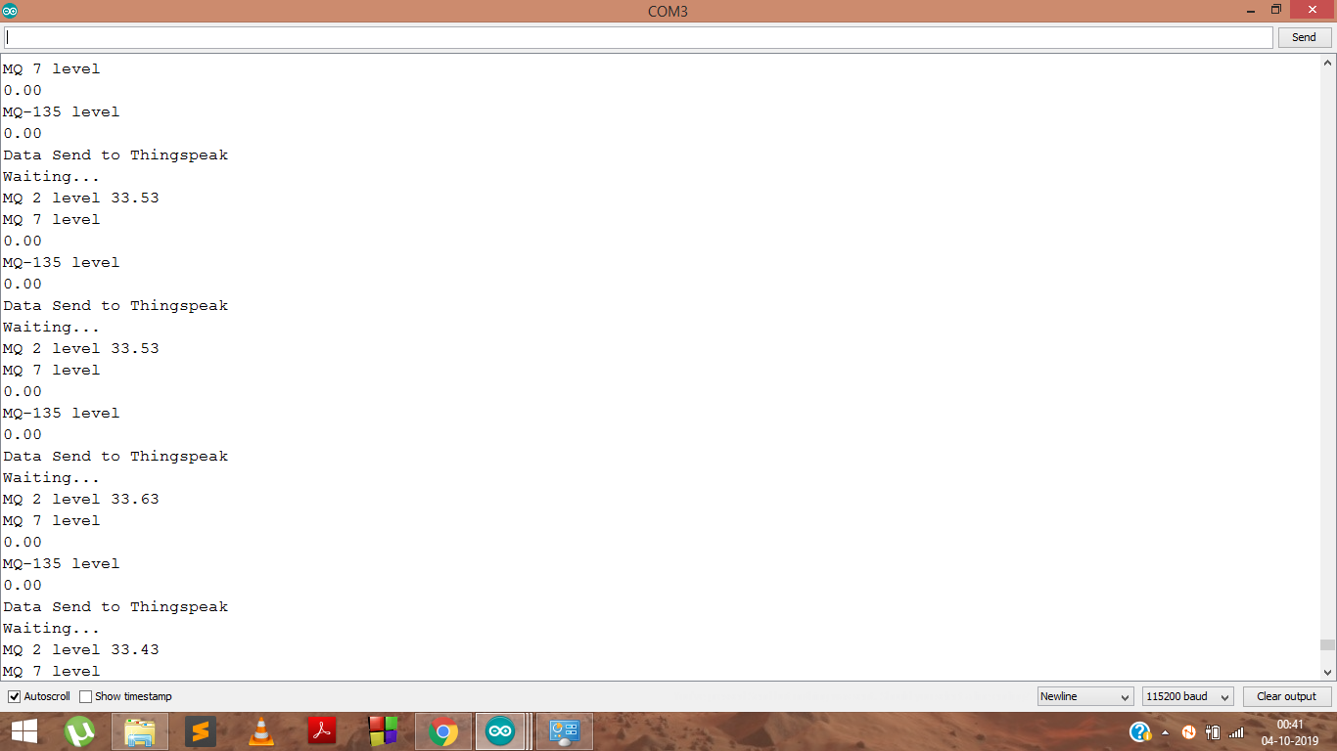
ScreenShots of the results:
This is the data sent by Node MCU to the Thingspeak server

Slide 12
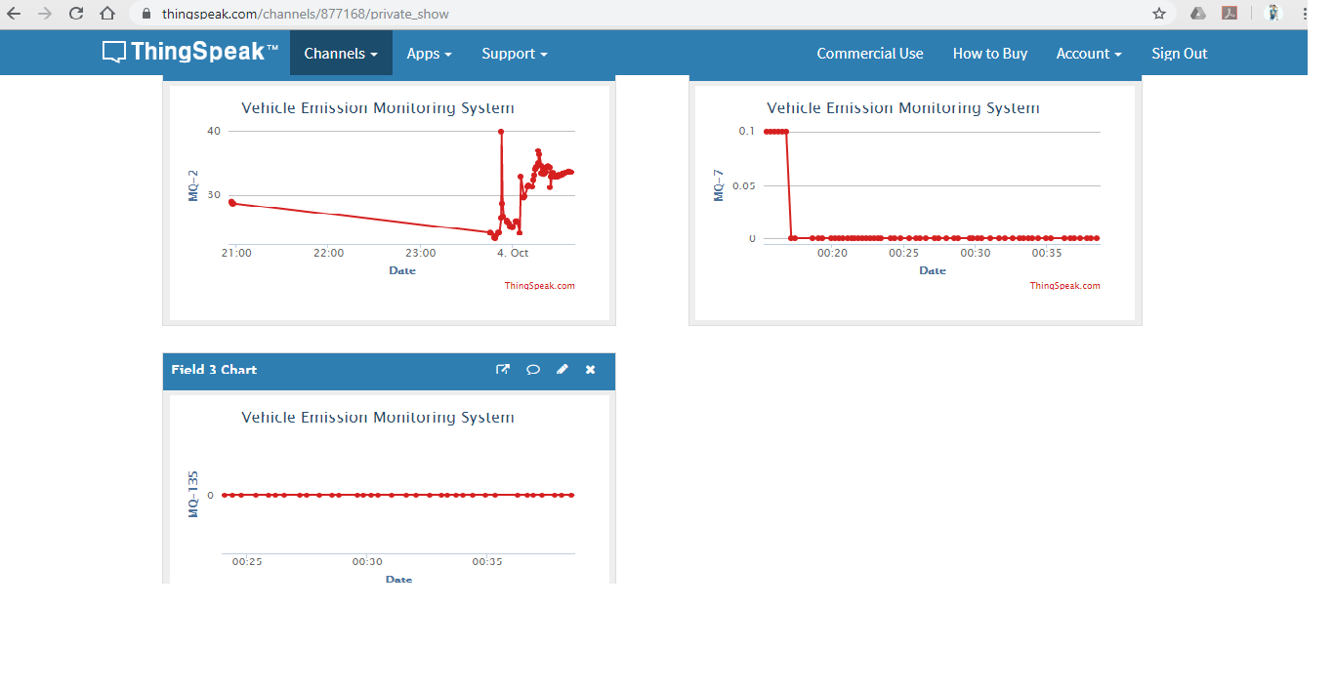
These are the graphs of the data received by Thingspeak server.

Slide 13
Further advancements remaining To be implemented :
Our next aim would be to send notifications to the vehicle owner’s mobile and the area’s Regional Transport Office (RTO) if any vehicle is emitting harmful gases above a certain limit.
LCD display will be added to display the readings.
Making it anti-destroyable.

Slide 14
Why is this useful?
We all have been witnessing the recent changes in climate which is impacting the whole world. Ex: Excessive heat during summers and extreme cold during winters, heavy rainfalls in a very short period causing floods are some of them.
A major reason of climate change are the harmful gases which our vehicles and factories emit.
The proposed system would help the authorities keep a track of each and every vehicle’s emission level thus will help in reducing pollution to a fair extent hence it’s an attempt towards a cleaner environment…..

Slide 15
Thank You !!

